Slide 1
Python Guru
Day 9
The Data Boot Camp |
November 29, 2018

Slide 2
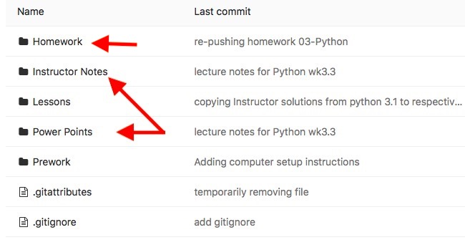
Adminitration
PowerPoint Presentation and classroom exercise solutions aare available on gitlab before class – see below.
Lecture materials are not delivered as-is out of the box.
PowerPoint Presentation is personally prepared by the instructor
Each class preparation takes approximately 5-7 hours of preparation

Slide 3
Refresher

Slide 4
Studen Activity: Cereal Cleaner
Let’s write our pseudo code:
# define items in my program:
# include helper library(ies) - dependencies
# add items for my prog
# define actions in my program:
# open the csv file
# create a csv reader
# read the header row and assign to a var
# print the header
# loop thru csv file
# to find cereal that are >= 5 gr of fibers
# if found print row

Slide 5
Agenda
Dictionaries
Create
Read
Write
Understanding of coding logic and reasoning
Functions
Loops
Conditionals
Git Commands
Create
Add
Commit
push

Slide 6
Let’s Start Coding

Slide 7
Dictionary
Like lists and tuples, dictionaries can contain multiple values and types of data within them
Unlike lists and tuples, dictionary stores elements are stored in key:value pair
The key in a dictionary can be a string or number used to reference the value it is associated with
The key must be unique within a dictionary
Elements are enclosed in { }
Dictionaries are immutable

Slide 8
List Comprehensions

Slide 9
Inline-For-loop
fish = ”halibut”
letters = [ ]
# create a list by looping thru each char
# of the string and push to an array
for char in fish:
letters.append( char.upper() )
# List comprehensions provide
# concise syntax for creating lists
letters = [char for char in fish]

Slide 10
Inline-For-loop Cont’d
[
[
letters
=
char
for
char
in
fish
add each char found to letters
loop thru each character in fish and assign it to char
[
[
newList
=
x
for
x
in
list
add each X found to newList
loop thru each item in the list and assign it to X
Final assignment variable is first in the equation on the right

Slide 11
Inline-For-loop + conditional
julyTemps = [87, 85, 92, 79, 106]
hotDays = [ ]
for temp in julyTemps:
if temp > 90:
hotDays.append(temp)
hotDays = [temp for temp in julyTemps if temp > 90]
Final assignment variable is first in the equation on the right

Slide 12
Functions

Slide 13
Usage
What?
A way for us to give a name to a set of instructions we want to be able to repeat.
Why?
Avoid redundancy = reusable codes
Less error-prone = consistency
Alleviate maintenance overhead
DRY vs. WET mantra:
Don’t Repeat Yourself (do’s)
Write Everything Twice (don’ts)
https://en.wikipedia.org/wiki/Don%27t_repeat_yourself

Slide 14
Anatomy
Parameters or Arguments?
A parameter is the name of a variable in a function
An argument is the value that is passed to the parameter
Arguments are positional therefore position matters unless:
using optional argument(s): default value is provided
using named arguments in passing in values
Usage:
A function must be defined before calling (executing) it

Slide 15
Syntax
def name(parameters):
# code goes here
return #optional
def show(message): #function accepts 1 param
print(message)
show("I’m a function!") #calling the function passing 1 arg
def add(x, y): #function accepts 2 params
return(x + y)
result = add(5,10) #calling the function passing 2 args

Slide 16
Optional Parameters
def make_quesadilla(protein, topping="sour cream"):
quesadilla =
f"Here is a {protein} quesadilla with {topping}"
print(quesadilla)
# using optional args
make_quesadilla("chicken")
#using positional args
make_quesadilla("beef", "guacamole")
# using named arguments
make_quesadilla(
topping="ranch dressing", protein="chicken")

Slide 17
Introduction to git

Slide 18
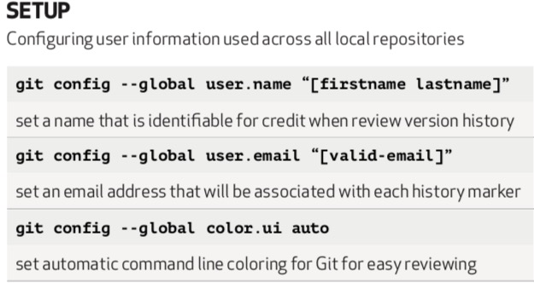
Basic Commands

Slide 19
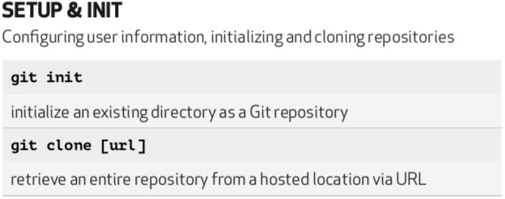
Basic Commands Cont’d

Slide 20
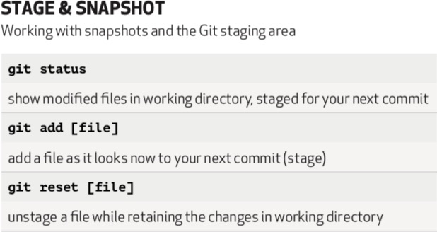
Basic Commands Cont’d
git add . to add all

Slide 21
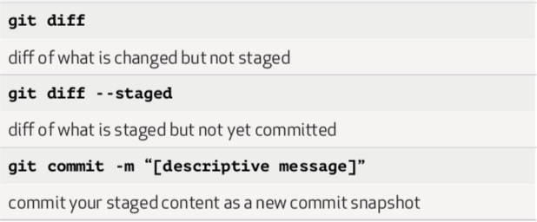
Basic Commands Cont’d
git push publish your change after git commit

Slide 22
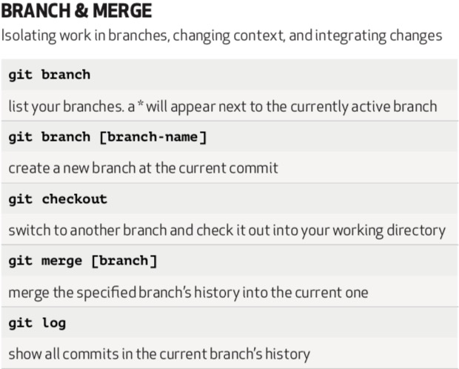

Slide 23
Helpful Links
Regex (aka Regular Expression)
*** http://users.cs.cf.ac.uk/Dave.Marshall/Internet/NEWS/regexp.html
https://docs.python.org/2/library/re.html
https://docs.python.org/2/howto/regex.html#regex-howto
https://www.tutorialspoint.com/python/python_reg_expressions.htm
Git
vscode git history
https://www.youtube.com/watch?v=VOwyH2-VCVY#action=share
Basic git commands
https://dont-be-afraid-to-commit.readthedocs.io/en/latest/git/commandlinegit.html

Slide 24
Questions / Discussion
Notes:
It’s important to keep in mind why you joined this class. Let’s talk about your goals.

